Slide 1
Outline
Summary
PnR with DRC and LVS
Introduction
Directed Testbench
Layered Testbench
Design RTL
Synthesis
Optimization
Final Parameter
Acknowledgement and References
Presented by: 1906174

Slide 2
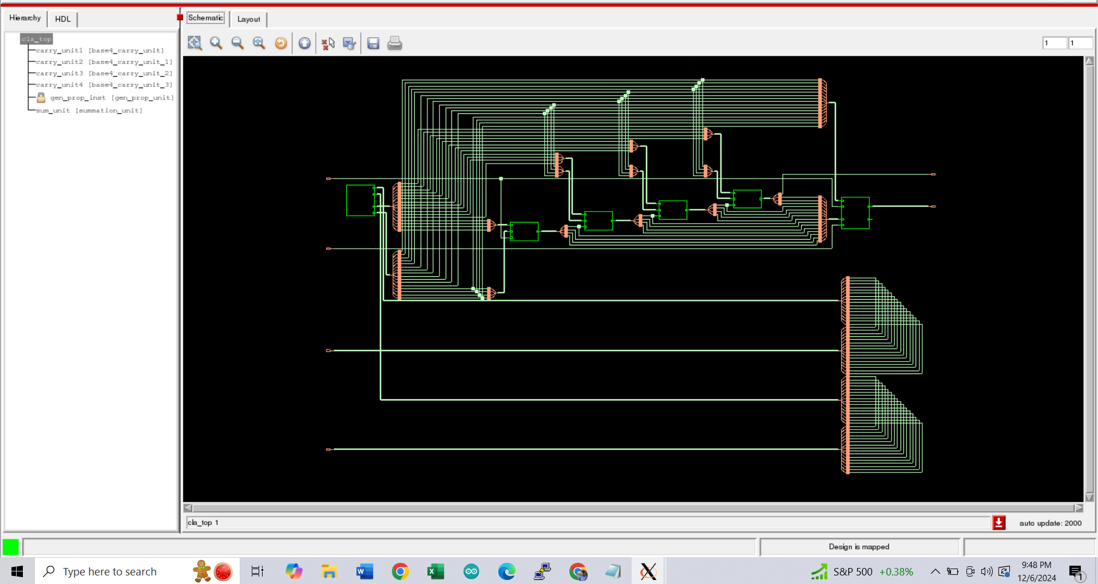
Fig: Schematic of Carry Lookahead Adder
Presented by: 1906174

Slide 3
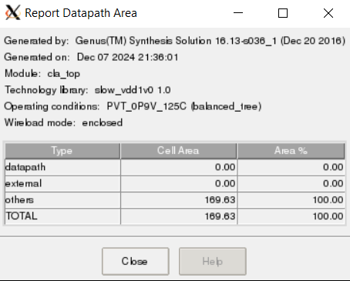
Fig: Report Of Datapath Area
Presented by: 1906174

Slide 4
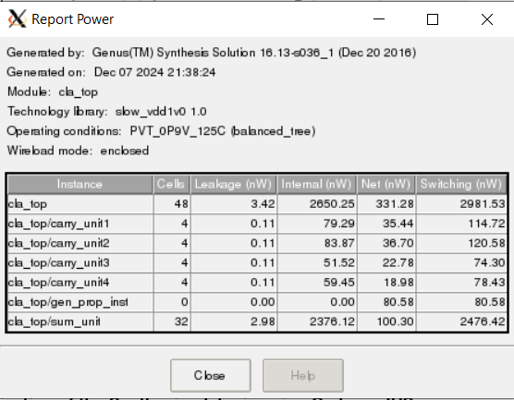
Fig: Power Report
Presented by: 1906174

Slide 5
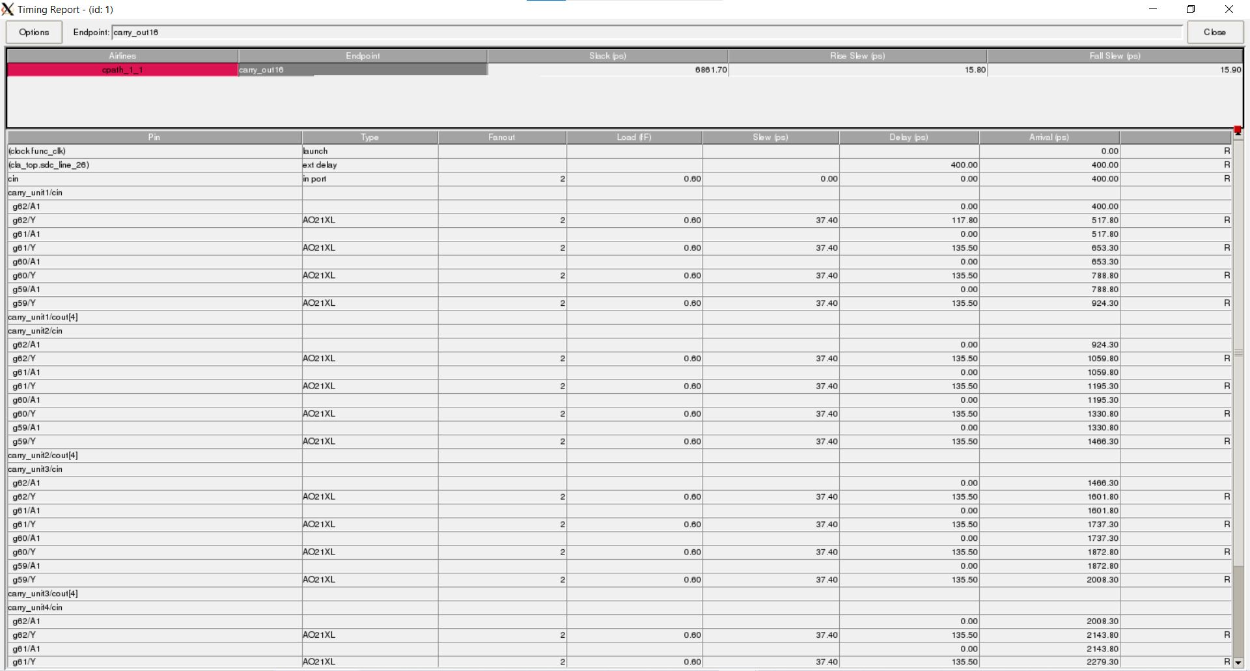
Fig: Timing Analysis
Presented by: 1906174

